Slide 1

Online Programs & Parental Involvement
Bridgeprep Academy of Greater Miami
Ms. Ortiz, Principal
Mrs. March, Assistant Principal

Slide 2






What are your biggest concerns with school at this time?
Quick Poll

Slide 3

New World of Learning
It takes a village to raise a child.
  Looks different in each family and classroom.
  Teachers are dealing with different modalities and new issues arise everyday.
How can we make things better?
Stay connected with teacher and school.
Hold your child accountable for their work and their participation.
Follow school rules and procedures
Be present
Be understanding
Be patient
Be kind

Slide 4

Online Programs
Help us build independent thinkers by allowing them to make their own mistakes and work on getting better!

Slide 5
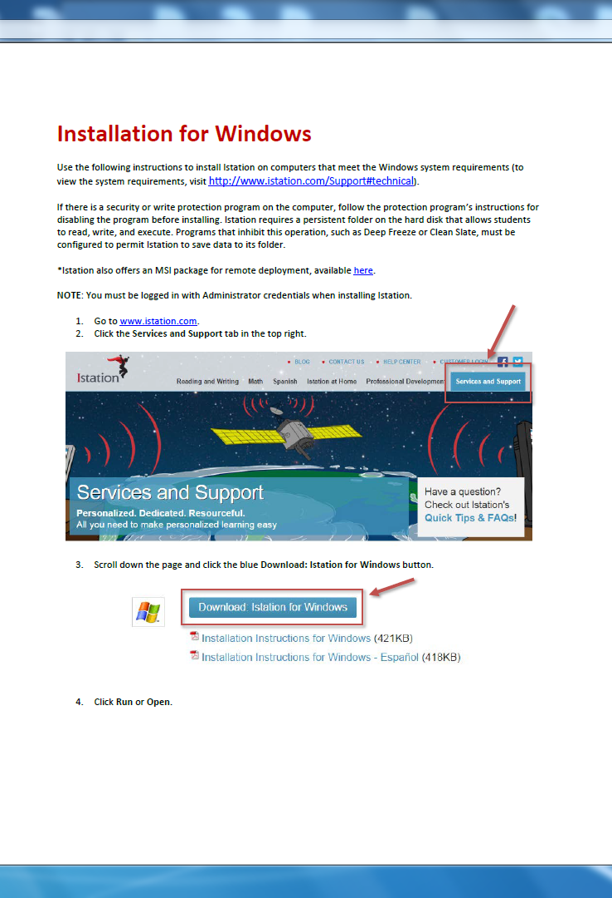
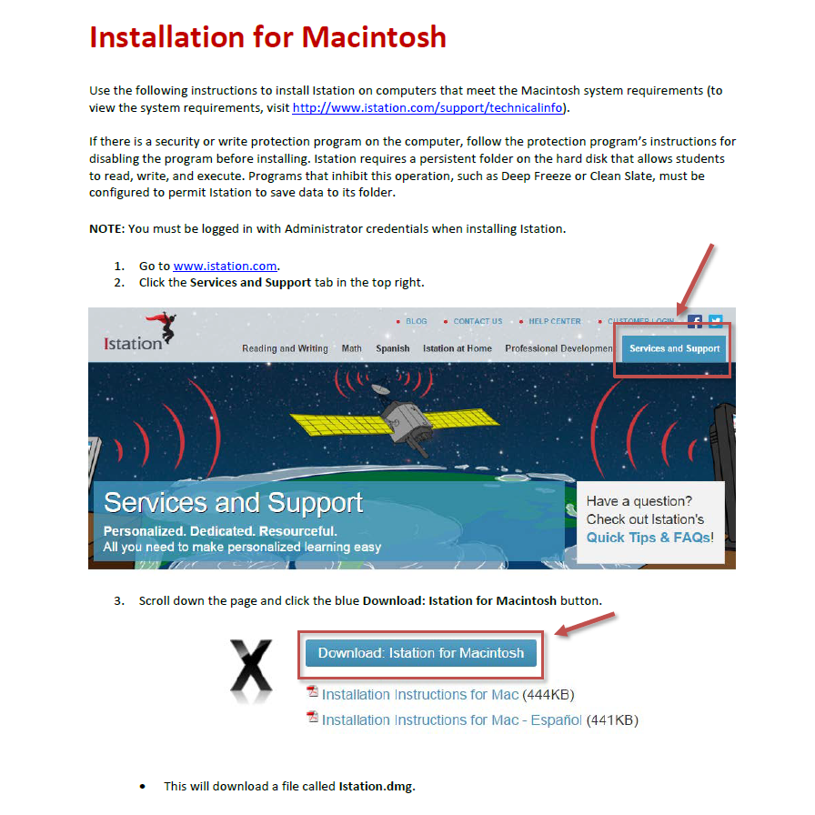
ISTATION
Reading, Math and Spanish Intervention program.
https://info.istation.com/reading_ebrochure
Must download the Istation Application to your computer.
Istation Support

Slide 6
ACHIEVE 3000
What is Achieve 3000?
Achieve3000 is the leader in online differentiated instruction, serving millions of students worldwide. For over 15 years, the company has been reaching students at their precise Lexile® reading levels to deliver significant reading gains.
https://vimeo.com/172412234
How to Log in?
https://login.achieve3000.com/index

Slide 7
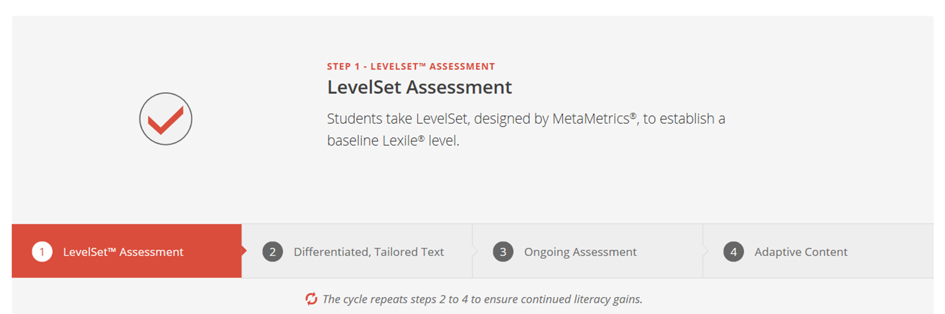
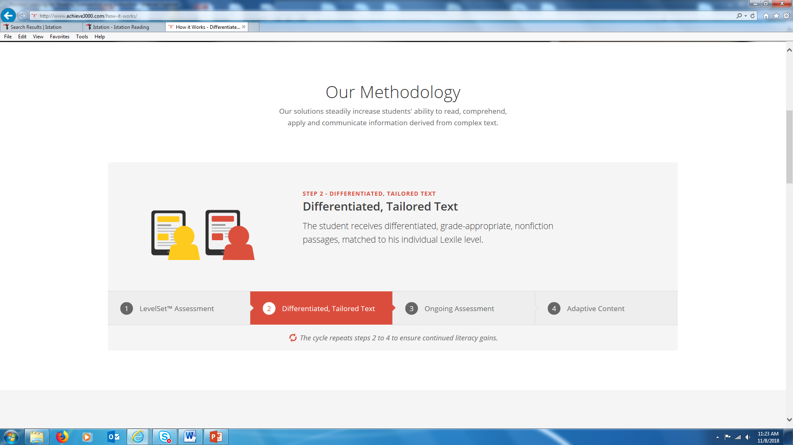

Slide 8
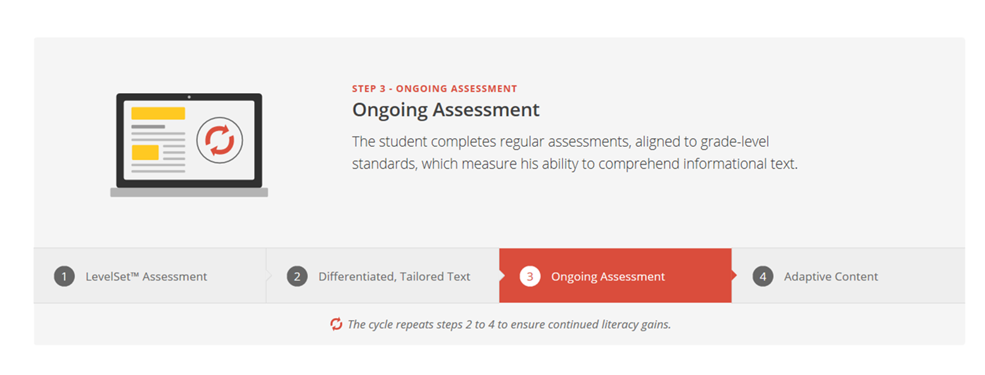
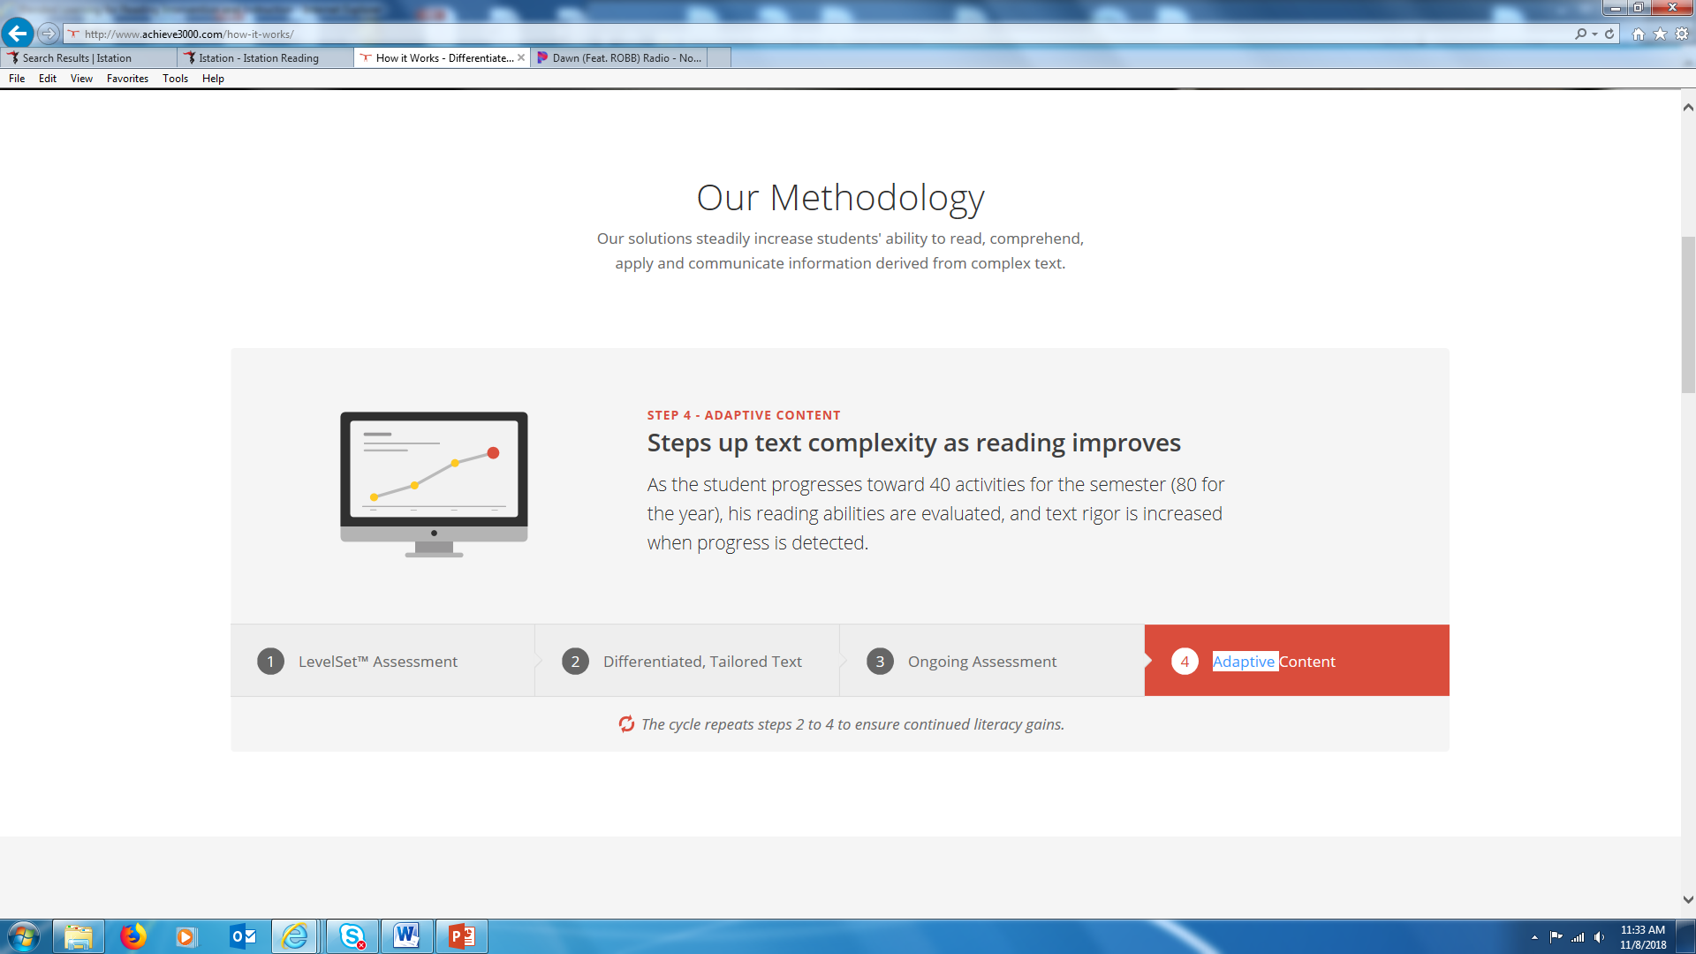
Achieve 3000

Slide 9
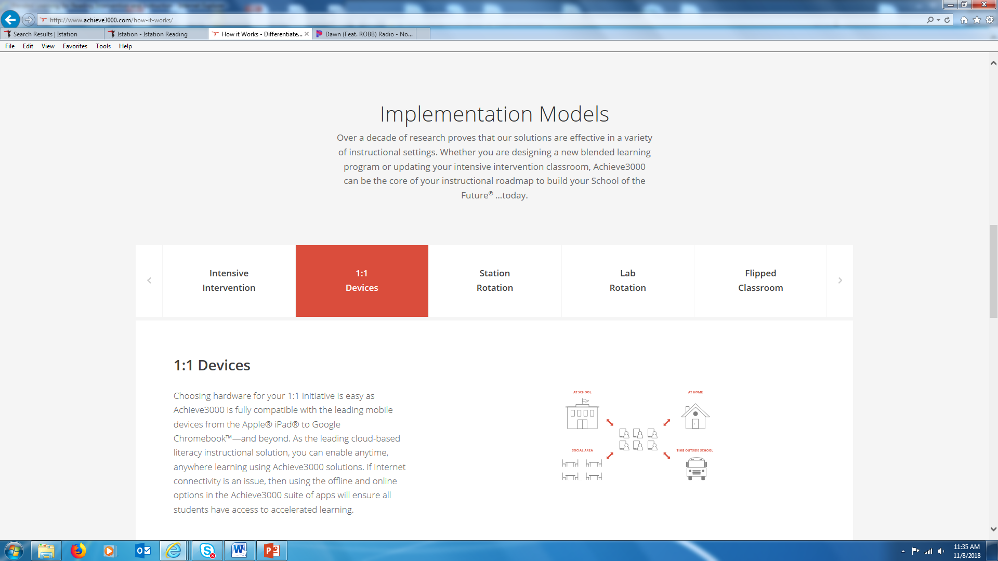

Slide 10
Parental Involvement
Class Dojo
  https://www.classdojo.com/about/
Student Grades
  http://www.dadeschools.net/parents.asp
Bridgeprep Academy Website
  https://bridgeprepgreatermiami.com/
Parents’ Guide to Student Success by PTA
  https://www.pta.org/home/family-resources/Parents-Guides-to-Student-Success

Slide 11





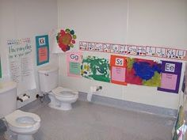
Reading Everywhere!

Slide 12




Slide 13
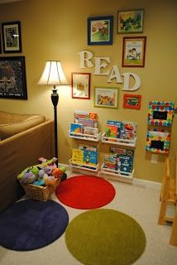
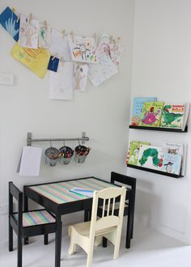
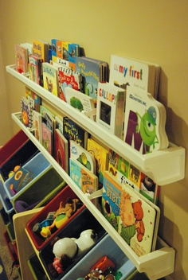
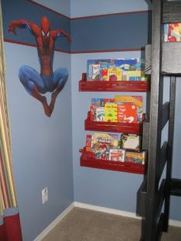


Slide 14
Remember These 10 Guiding Principles
Family members are equal partners in a child’s education.
The home environment is the “primary” educational environment.
Schools must respect the diversity of families and their varied needs.
All families care about their children.

Slide 15
Family involvement is important through all years of a child’s education.
Family involvement takes many forms and may not require a family’s presence at school.
Families, schools, and communities are closely interconnected and must collaborate in educating children.

Slide 16

Thank you for trusting us with your child. We are looking forward to a successful school year.

Slide 17
Questions/Concerns?
WE APPRECIATE YOUR FEEDBACK!
https://www.bridgeprepgreatermiami.com/
  Google Review

